Slide 1
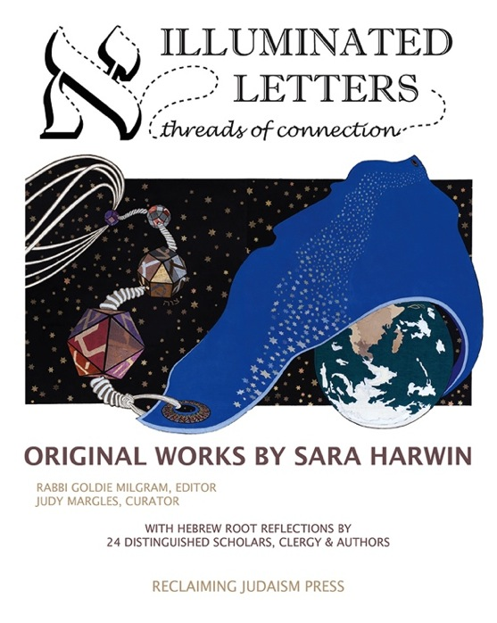
and a Guide to Exploring Biblical Hebrew
Invitation to Create Your Own Root Reflection

Slide 2
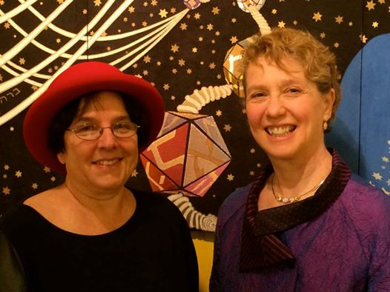
Sara Harwin (right), Artist and Rabbi Goldie Milgram (left), Editor invite you to

Slide 3
Create a personal reflection on one of 18 Hebrew Roots
Continue for instructions for juried 250 word or visual art submissions and guide for the Beginners and Intermediates in Biblical Hebrew

Slide 4
Juried Submission Instructions
1. Jewish professionals skip to #2. Lay persons, kindly obtain the exhibition volume, Illuminated Letters: Threads of Connection, as it contains 24 examples. Buy Now
2. We are looking for personal spiritual reflections on one of the 18 roots, or upon a word or phrase that involves one of the roots. If you are already familiar enough with Biblical Hebrew to select a root and begin to write/illustrate/weave/sculpt/film, etc. a reflection for juried consideration, first inquire which roots are currently available. [Shavat, for example, already has a full panel.]
Send your piece or questions to: rebgoldie@gmail.com
3. If you would like a guide to some of the 18 roots and how Biblical Hebrew works as a spiritual language and why, continue with the next slide.

Slide 5
Biblical Hebrew comes from Proto-Semitic possibly the oldest of all the human language branches Because of its Semitic language structure, Hebrew is an inherently SPIRITUAL language.
Learn why & how

Slide 6
Understanding Biblical Hebrew: An Invitation to Understanding and Personal Connection by Rabbi Goldie Milgram Editor-in-Chief Reclaiming Judaism Press

Slide 7
Tree-related metaphors are helpful for understanding Biblical Hebrew

Slide 8
The tree metaphor comes from the Garden of Eden Story
Eve and Adam ate from the fruit of the Tree of Knowledge

Slide 9
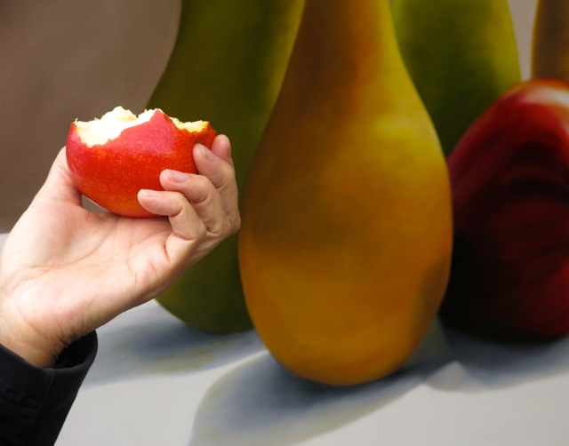
A useful “trick” question What was the fruit Adam and Eve ate?
©2104 Barry Bub

Slide 10
Actually, it was not an apple.
ן Gen: 3:3 …from the fruit of the tree that is in the middle of the garden
Gen: 3:6 …She took from its fruit and ate and also gave it to her man, who was with her, and he ate
When one can access the original text in Hebrew, one readily sees that what they bit into in the Bible is a fruit
pronounced pree, who’s meanings can be fruit(s) of the womb, knowledge, one’s actions, or of a tree, plant or experience

Slide 11
Interpretive Levels
Tradition holds there are multiple Biblical interpretive levels and all are valuable and real, the acronym for this is P.A.R.D.E.S. which is Hebrew for “orchard”.
P: Peshat, the literal meaning of the words/story
R: Remez, hints, often metaphors in the text that open up new possibilities for its meaning
D: Drash, imaging unspoken scenarios based on gaps and creative opportunities to develop stories and characters further S: Sod, the mystical dimension that opens us up to glimpses beyond what our rational mind can offer

Slide 12
So, what does the metaphorical dimension of the text imply was the fruit from which they “ate”? Awareness
“Knowledge of good and evil” or, as God puts it in the story: “The earthling has become like one of us.”
Genesis 3:22

Slide 13
Notice how important the Biblical Hebrew is, for once we know that the species of fruit is unspecified, it helps us to recognize how the text/the Divine is apparently using fruit as a metaphor Even a little Hebrew, one word in this case, reveals portals of meaning embedded within the original text.

Slide 14
The earthlings’ next developmental stage is marked by being pushed out of Eden (note the birthing metaphor) for having eaten of the Tree of Knowledge and to prevent them from eating of the Tree of Life. They are now required to apply the knowledge they have gained by living on and working the land (adamah) from which the first earthling (Adam), was made. Can you hear the relationship of those two Hebrew terms?

Slide 15
What do we know about the other tree, the Tree of Life beyond the prohibition to eat from it directed to the first earthlings in the Eden story?

Slide 16
1. The roots of “The Tree of Life” are Hebrew letters
2 or 3 Hebrew letters came together to form each Hebrew root

Slide 17
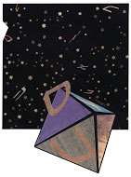
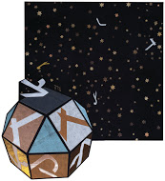
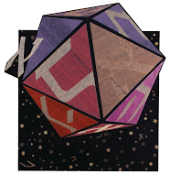
Sara Harwin’s exhibition uses what she calls “particles” to imply the DNA-like quality of Hebrew through the traditions of sacred geometry
© 2014 SARA HARWIN

Slide 18
2. Each Hebrew root then
branches out to bear
fruits that are sacred words each with a meaningful connection to the other.

Slide 19
Now, let’s look closer at our example:
red ah-dom
Adam/earthling ah-dahm
earth ah-dah-mah ⬆ Root shown inside of words (fruit)
on its branch on the Tree of Life
⬇Root:
blood dahm

Slide 20
And even closer, noticing how the Hebrew root and its derivative words flow into a continuum of meaning
* * dahm is blood, which is the Life Force in Jewish tradition, symbolized by grape wine in rituals *oust ah’dom is the color red
ah-dah-mah is the rich red earth from which Adam is made, which the earthlings must learn to work productively in order to survive
* ah-dahm, adam means “earthling”, a new life form made from the rich red earth
*Note above that the final letter on the left of the words, Mem, is now in its final form. In the middle and front of a word it looks like this:

Slide 21
What is the purpose of the existence of the fruit of the Tree of Life?
Did they/do we ever get to “eat” of it?

Slide 22
Yes! First, it is the Biblical Israelites
who first get sound “bites” from the fruit of the Tree of Life as mediated by Moses who brings Torah, “guidance” down from Sinai and then we all inherit the fruit of the Tree of Life, in each bite we take of the Biblical Hebrew

Slide 23
‘She’ [is a] Tree of Life
for those who grasp ‘Her’ Proverbs 3:18
TORAH, the Hebrew Scriptures is that very Tree of Life
And, “She” is the Divine cloaked in letters, words, phrases, sacred stories

Slide 24
Observe another root in action and look where it lands! Yarah shot, threw, cast as in shooting an arrow ⬇ yorah archer morah instructor horah parent Torah guidance i.e., how to aim and hit the mark

Slide 25
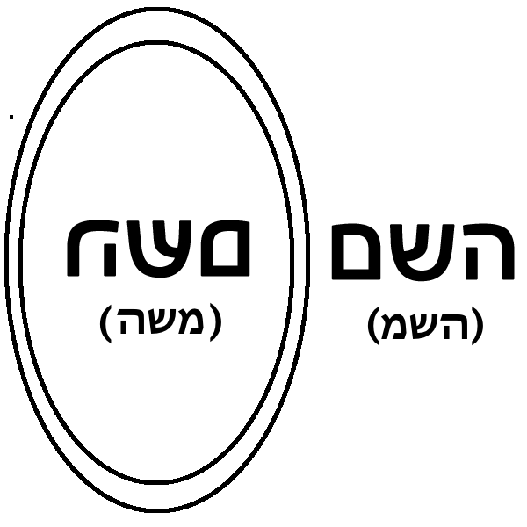
Hebrew words often are portals to higher consciousness
In a mirror hold up the letters Hey Shin Mem You will see the name of Moses facing you in the reflection. HASHEM, “The Name” is first found in Deut. 28:58 and often used by pious Jews to refer to the Divine when not at prayer.
Because some letters have different forms at the end of a word, HASHEM looks like this in a formal text:
Moses

Slide 26
Take a breath
That last slide is a big moment in Biblical Hebrew awareness, going back to it and taking it in contemplatively might be helpful. What might be some of the spiritual implications?

Slide 27
Learning bites of Biblical Hebrew helps one to obtain a better view by lifting you up into the original branches of the Tree of Life, The greatest power and mystery, joy and delights of the Torah are embedded in the DNA of the Hebrew

Slide 28
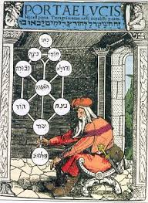
The Tree is found in Kabbalah, too
In the mystical tradition The Tree of Life is the metaphor for the manifestation of the Divine.

Slide 29
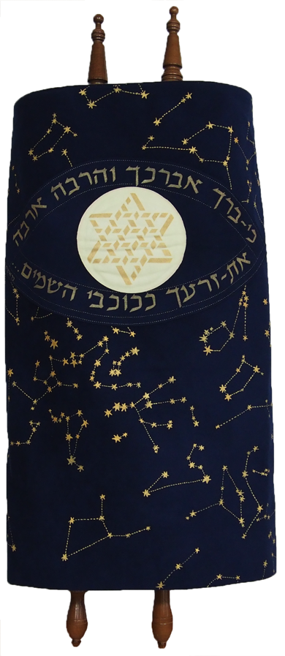
Both the Torah is termed
the Etz Chayyim (Tree of Life)
and the wooden rollers
upon which the scroll is wound.

Slide 30
Inspired to learn? Here come some helpful tools.
Brown, Driver and Briggs is a Lexicon that shows the diverse meanings of Biblical words with contextual examples. Here’s a taste of one root…errr…fruit!
1 light as diffused in nature, light of day Genesis 1:3,4,5 (P) Job 3:9; Job 38:19 +.
2 morning light, dawn, light of the morning Judges 16:2; 1 Samuel 14:36; 1 Samuel 25:34,36; 2 Samuel 17:22; 2 Kings 7:9; Micah 2:1; 2 Samuel 23:4 (poem of David)...
3 light of the heavenly lumina moonlight & sunlight Isaiah 30:26; stars of light Psalm 148:3; luminaries of light Ezekiel 32:8; Psalm 136:7; so in sunshine Isaiah 18:4; the sun itself Job 31:26.
There are 11 entries for this root, let’s view some more

Slide 31
4 daylight light of the wicked Job 38:15 (their work-day being the night); a day of light Amos 8:9 (= a clear, sunshiny day).
5 lightning Job 36:32; Job 37:3,11,15 compare Habakkuk 3:11.
6 light of lamp Proverbs 13:9; Jeremiah 25:10; of crocodile's hot breath Job 41:10.
7 light of life Job 33:30; Psalm 56:14; compare Job 3:16,20.
8 light of prosperity Job 22:28; Job 30:26; Psalm 97:11; Lamentations 3:2.
9 light of instruction Proverbs 6:23 the commandment is a lamp and instruction a light; so as a light to the nations Isaiah 42:6; Isaiah 49:6; and a leader shining as a great light Isaiah 9:1 (twice in verse).
10 light of face = bright, cheerful face (of men) Job 29:24; betokening king's favor Proverbs 16:15 (compare Psalm 38:11); of God = shining, enlightening, favoring face Psalm 4:7; Psalm 44:4; Psalm 89:16.
11 God as the light of Israel Isaiah 10:17, as source enlightenment & prosperity; light & salvation Psalm 27:1; light to guide Micah 7:8 compare Psalm 43:3; everlasting light of Zion, instead of sun & moon Isaiah 60:19,20; house of Jacob is to walk in his light Isaiah 2:5.

Slide 32
Also, consider comparing and contrasting “translations”
Take a word in a verse of Torah and look it up in multiple translations. This will help you to attain a sense of how very much a translation is really an individual or denominational commission’s interpretation.
Let’s look at a helpful resource for doing so:

Slide 33
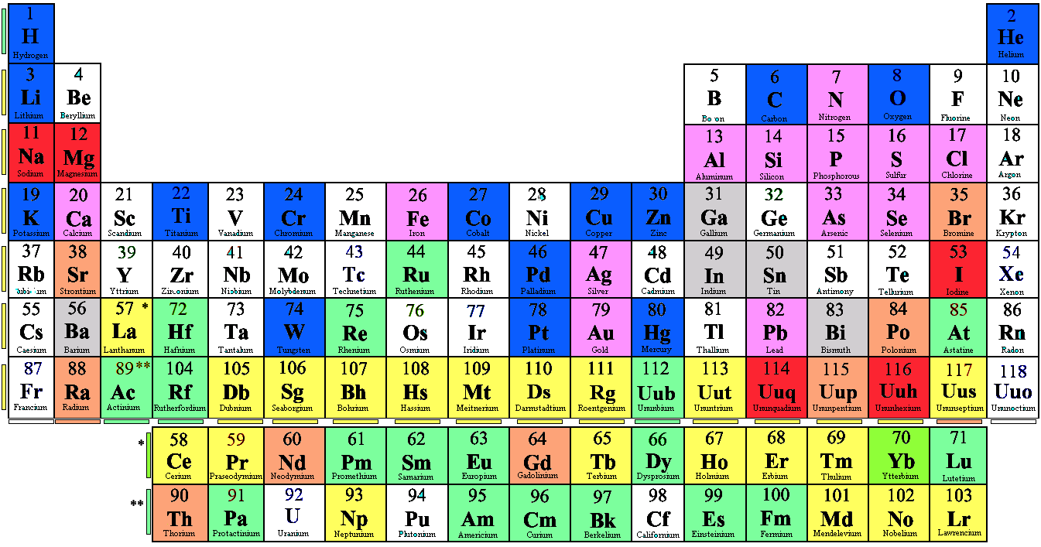
Much as scientists have articulated the ever-evolving
Table of the Elements, and have spelled out the
human genome, so too, do researchers maintain
tools such as concordances and Strong’s Numbers
and Lexicons for working with the spiritual DNA
of the Hebrew language.

Slide 34
James Strong (1822-1894) numbered every Hebrew root, creating the ability to generate lists of every word, its associated root, meanings and where it appears in Torah, the Hebrew Scriptures.
Let’s look at an example:

Slide 35
Disclaimer: We could not find a free Jewish site on-line that provides certain tools normal to researching Biblical Hebrew roots and words, but we did find some Christian sites that provide useful tools, especially the Gesenius dictionary, concordances, and Strong’s numbers. These will be cited.

Slide 36
215 is a hyperlinked Strong’s Number for אור The site, Blueletterbible.org* also offers a Biblical Hebrew dictionary by Gesenius (1786-1842).
Note that the letter "C" under the term Tools appears to the left of a verse that comes up on a key word search, provides a full concordance to find the verses where each word appears. .

Slide 37
Comparative “translation” example Genesis 24:64 Strong’s Number H5307 for the root NAFAL Meaning: fall, cast or lie down, fail, prostrate
Jewish Publication Society 1917: And Rebekah lifted up her eyes, and when she saw Isaac, (“va-teepole”) she alighted from the camel.
King James Version: And Rebekah lifted up her eyes, and when she saw Isaac, she lighted off the camel.
But what does va-teepole actually mean? “She fell.” The English doesn’t reveal the colloquialism that is obvious in Biblical Hebrew: “She fell off her camel for him”, in other words it was “love at first sight.”

Slide 38
The spirituality of Hebrew is embedded in every word
From the root (bet-resh-hey) emerges:
bah-rukh, bless bah’rakh, bend beh-rekh, knee b’rei-kha, pond b’rakha, blessing b’rah-khot, blessings
Rabbi Joseph Gikatilla (13th century) taught the sequence above to reveal how each root word branches into nuanced, poetic meanings. Barukh at the beginning of each Hebrew blessing now takes on a powerful embodied sense of gratitude from receiving : and expressing full: “I bend my knee at the Pond of Blessings”

Slide 39
Some translations to compare when exploring a term’s meaning and potential in context
Eitz Chayyim: A Torah Commentary Robert Alter, The Five Books of Moses: A Translation with Commentary Everett Fox, The Five Books of Moses, The Schocken Bible The JPS Tanakh Aryeh Kaplan, The Living Torah W. Gunther Plaut , et. al. The Torah, A Modern Commentary
N. Scherman, ed., The Chumash: The Torah: Haftoros and Five Megillos, Stone edition, Artscroll
The Holy Scriptures, (also known as The Jerusalem Bible) Koren
Websites: Bible.Ort.org Machon-Mamre.org Chabad.org Biblehub.com Blueletterbible.org Scripture4all.org

Slide 40
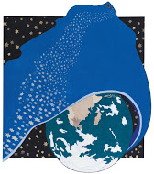
In conclusion
Sara Harwin's Illuminated Letters: Threads of Connection exhibition expresses her vision of both individual and integrative appreciation of eighteen roots found in Biblical Hebrew.
If you wish, now return to the beginning to review the roots and criteria for submissions. Then let us know of your interest and we’ll let you know which roots remain available for submissions for juried review toward inclusion in either or both the exhibition and companion volume. Questions : Editor-in-chief, Reclaiming Judaism Press Rabbi Goldie Milgram rebgoldie@gmail.com

Slide 41
A COLLABORATION OF
Reclaiming Judaism Innovative programs & resources for meaningful Jewish living RECLAIMINGJUDAISM.ORG

